Slide 1

Project report
Phase modulation
Presented by:
22BEC502 Prit barot
22BEC508 Darshil mavadiya

Slide 2
INTRODUCTION
Modulation is simply refferred to as the alteration of a signal with respect to a carrier signal containing the message which needs to be sent over a channel. The main reason why
modulation is vital in a communication system is because of both the radiated power and the size of an antenna i.e. with a signal with a small frequency will need a large antenna considering that frequency is inversely proportional to the wavelength. The phase
modulation technique is a common technique where the message/carrier signal is added to a modulating signal by altering its phase.
Even though the phase modulation is rather uncommon owing to its similarities with the Frequency Modulation, it serves as a basis for the Phase Shift Keying(PSK), Binary Phase Shift Keying(BPSK), Offset Phase Shift Keying (OPSK)and other complex modulation techniques such as the Quadrature Amplitude Modulation technique(QAM).
THEORY
Phase is simply the point rate change as it moves round a circular orbit. Notably it is the
integral of the frequency with respect to time. This is can be proved because the integral of the signal is equal to the time shifted version of that signal which is as a result of a change in the phase angle.
Phase modulation works by altering the phase angle such that with a positive change in the phase angle leads to a phase modulated wave which leads the carrier signal while the phase modulated wave lags the carrier signal. In the time domain the slope of the baseband(modulating) signal affects the phase angle while in the frequency domain it’s similar to the Frequency modulation (FM) technique.
The final Pulse modulated signal is a function of both the carrier signal and the baseband signal and the modulation index. The index is also referred to as the the phase deviation denoted by either m or Kp which affects the sensitivity of the Baseband signal and is also proportional to the modulation voltage, the index has the units (rad/V).
PROJECT OBJECTIVES
This project had the main objective being to implement a Phase Modulated wave using a modulator by adding a baseband signal to the orignal carrier signal and a demodulator which had an output of the original carrier signal. The project also aimed at enhancing my competence in circuit design by combining certain theoretical concepts from analog and
digital communication and implementing them in a computer software such as Multisim. It also involved conceptualizing the process of Phase modulation and comparing this with the Amplitude and Frequency modulation techniques. Finally the project aimed at enhancing my understanding on the phase modulation process for building other complex techniques such as the QAM and PSK.

Slide 3
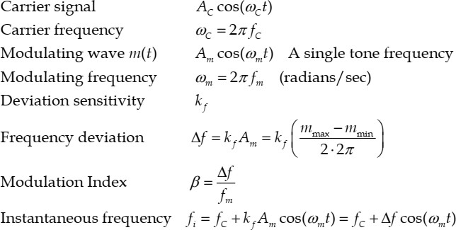
Circuit diagram
EXPERIMENTAL DATA

Slide 4
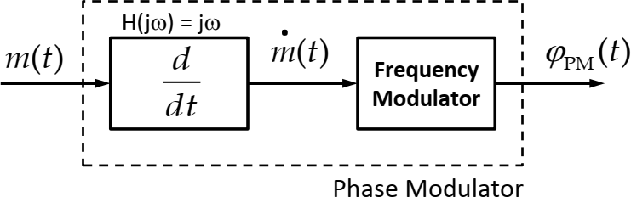
This first part comprised of the stable oscillator, phase detector and frequency divider part. At this point the goal was to handle the carrier signal such that it had its reference to the oscillator’s signal phase and then comparing the two waves by verifying their difference so as to adjust the signal generated. The frequency divider part was useful for dividing the carrier signal such that it was a multiple of the reference oscillator signal. The output of this waveform Vout was upon the condition that there was a phase difference in the waveforms (an important part in the phase modulation process) because that change in phase is what we need to modulate the carrier signal.
The second part involved the modulation process which I did achieve by multiplying or mixing the modulating/baseband signal with the carrier signals to produce the final pulse modulating signal as the output.
For the above setup the message/carrier signal passes a differentiator with a transfer function expressed as H(jw)=jw such that the output is a modified message signal equivalent to the differential of the message signal. Bearing in mind the integral of the signal is the time shifted version of that signal which is as a result of the change in phase in the setup, the
modulator had an output in form of a phase modulated wave with an offset phase.

Slide 5
CONCLUSION.
The phase modulation technique is achievable but it’s rather easier to implement the FM or the AM techniques. Though the Phase modulation is more suitable for analog signal
transmission mainly because of its continous in nature thus the signal distortion is minimal. The PM technique is favourable modulation technique for all data communication such as the Phase Shift Keying technique and other modern communication techniques such as the Quadrature Amplitude technique, used in the Wi-Fi technology, which involves changing both the amplitude and phase angles.
APPENDIX
[1] B.P Lathi and Zhi Ying , Modern Digital and Analog Communication systems. 4th Edition. New york:Oxford University Press, 2010.

